Slide 1



Mississippi HPC Conference 2024

Slide 2
Goals of the HPC Club
The primary goal of the HPC Club is to foster interest in High Performance and Parallel computing among all majors at MSU.
The HPC Club also serves to provide opportunities for students to participate in the HPC community.
Finally, the HPC Club provides basic training on skills needed in the HPC community.

Slide 3
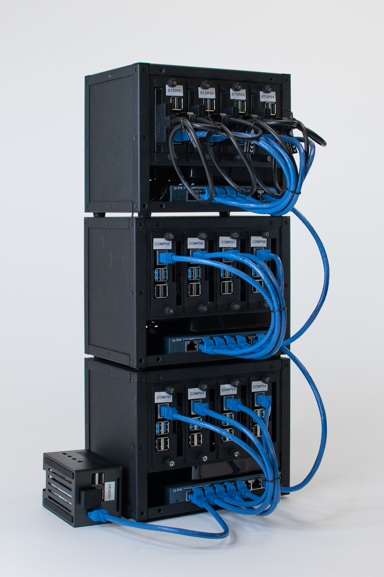
Head Node
Raspberry Pi 4 B
Quad core Cortex-A72
4 GB RAM
120 GB SSD
8 Compute Nodes
Raspberry Pi 4 B
Quad core Cortex-A72
4 GB RAM
4 Storage Nodes
Raspberry Pi 4 B
Quad core Cortex-A72
4 GB RAM
250 GB SSD
Replicated GlusterFS
Prometheus
Prometheus is a Raspberry Pi cluster built by the HPC Club as an inexpensive learning model.
Total Compute 32 Cores, 32 GB RAM, 500 GB Parallel Storage, 50 GB Shared Storage

Slide 4



PI HPC
PI HPC is intended on providing a guide on how to setup a Raspberry Pi cluster and a repository of resources for configuration and demonstration for this cluster.
It is a jumping-off point where students and instructors can further explore cluster computing at their own pace.
https://j3b.in/pihpc

Slide 5
Cluster Demonstration

Slide 6
Questions?

Slide 7
Thank You

